Slide 1
Prepositions practice from last week
We live _____ London.
They are walking ____ the bridge.
My birthday is _____ October 21.
Put the books ____ the table, please.
The monkey is hiding _______ the curtain.
The monkey is ______ the bed.
USING THE PREPOSITIONS, LET’S MAKE SENTENCES ON OUR OWN NOW.

Slide 2
tenses

Slide 3
Introduction
Past Tense - it already happened | Yesterday, I played outside.
Present Tense - it is happening right now | I play outside.
Future Tense - it has yet to happen | Tomorrow I will play outside.

Slide 4
Present and past tense - mostly done by adding ”ed”
Present tense | Past tense
It rains very much here. | It rained very much here.
It smells very delicious in the kitchen. | It smelled very delicious in the kitchen.
It snows a lot in winter in Russia. | It snowed a lot in winter in Russia.
I forget my wallet too much. | I forgot my wallet.

Slide 5
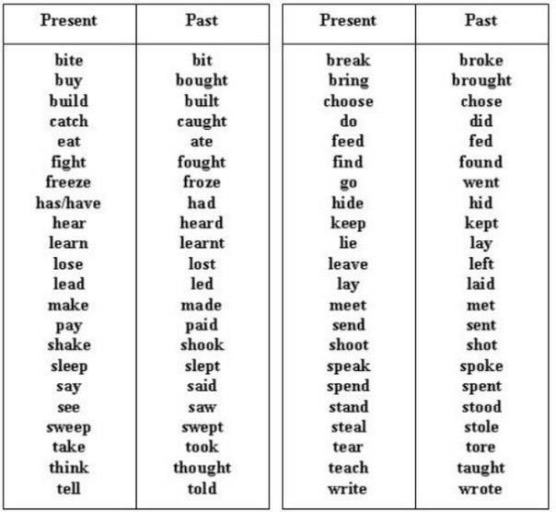
Other examples

Slide 6
Present and future tense -mostly done by adding “will”
Present tense | Future tense
It rains very much here. | It will rain very much here.
It smells very delicious in the kitchen. | It will smell very delicious in the kitchen.
It snows a lot in winter in Russia. | It will snow a lot in winter in Russia.
I forget my wallet too much. | I think I will forget my wallet.

Slide 7
Practice exercise
Make sentences and classify them as present, past or future.
(Look at the word document)

Slide 8
Video
https://www.youtube.com/watch?v=DPOm4Z-HpGY

Slide 9
More practice: identify the tense
1. Daniel will choose a baseball bat. _____________________________
2. He steps up in the stairs. _____________________________
3. The pitcher tossed the ball. _____________________________
4. Daniel will swing hard. _____________________________
5. The ball struck the bat. _____________________________
6. The ball flies through the air. _____________________________
7. It landed over the fence. _____________________________
8. Daniel will run around the bases. _____________________________
9. The crowd screams loudly. _____________________________
10. He will slide into home plate. _____________________________
11. Daniel's teammates cheered. _____________________________
12. Daniel smiled proudly. _____________________________

Slide 10
More practice: fill in the sentences
I ________ football with my friends tomorrow.
I ________ pizza for dinner yesterday. It ____ my favorite dish.
He _________ so much because he wants to get good marks in his exam.
I _______ early last night because I was tired.
As soon as I get up, I like to _____ my teeth.
My friends and I always _______ basketball together.
I _______ my phone bill tomorrow.

Slide 11
YOU DID A GREAT JOB ☺

